Slide 1
SOLID Software Design Principles in Java
COURSE OVERVIEW

Slide 2
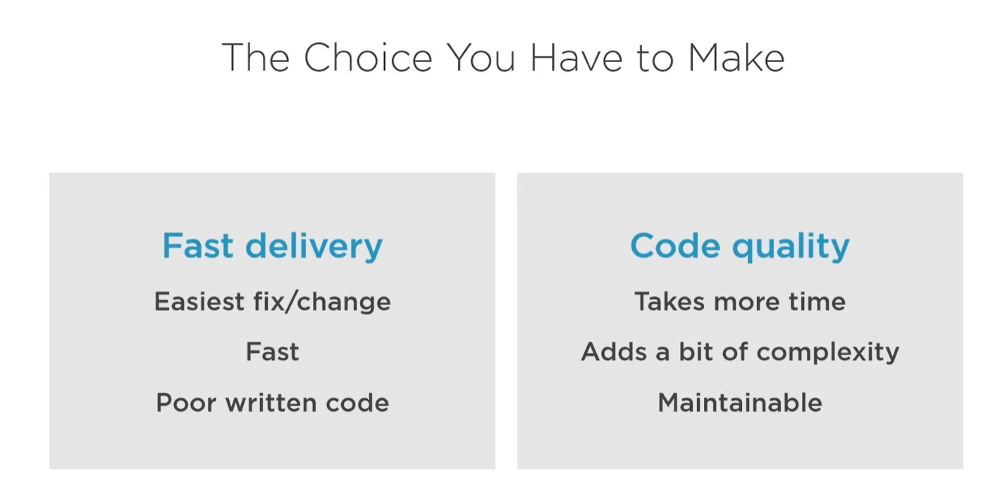

Slide 3
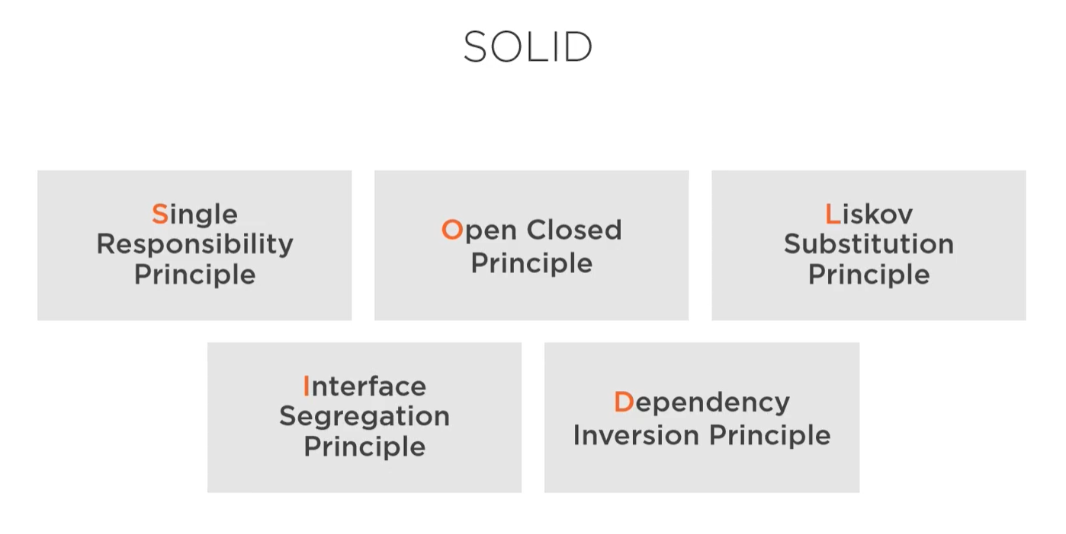

Slide 4
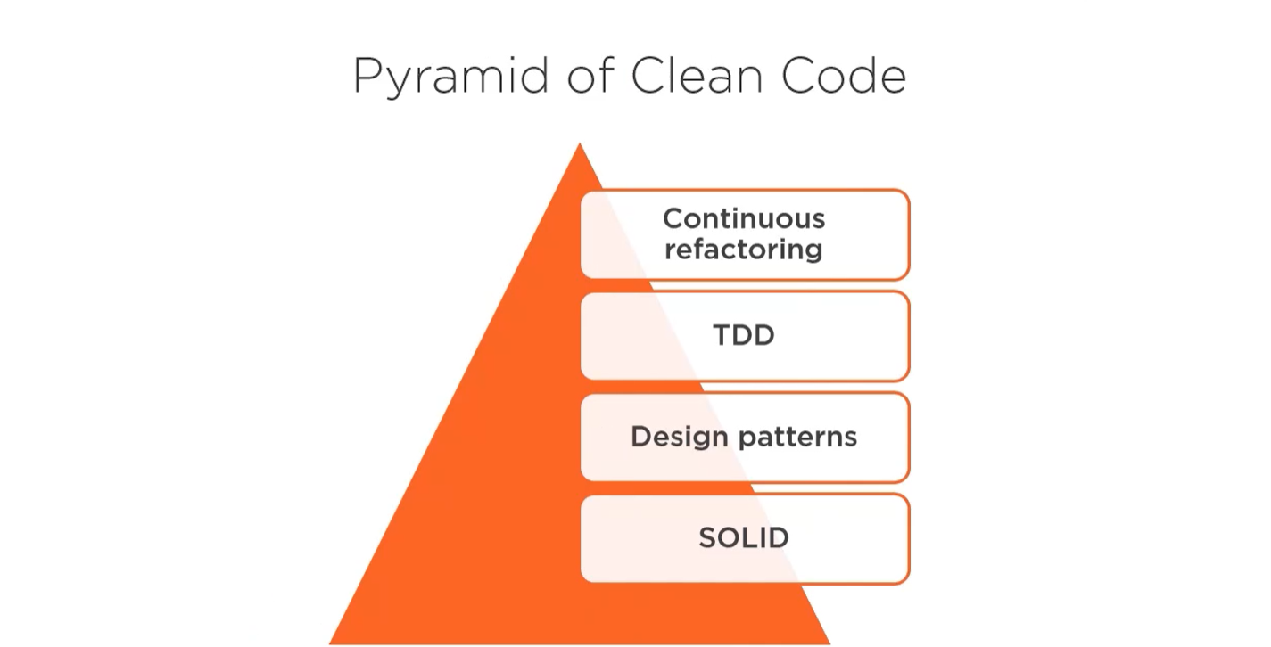

Slide 5


Slide 6


